Slide 1

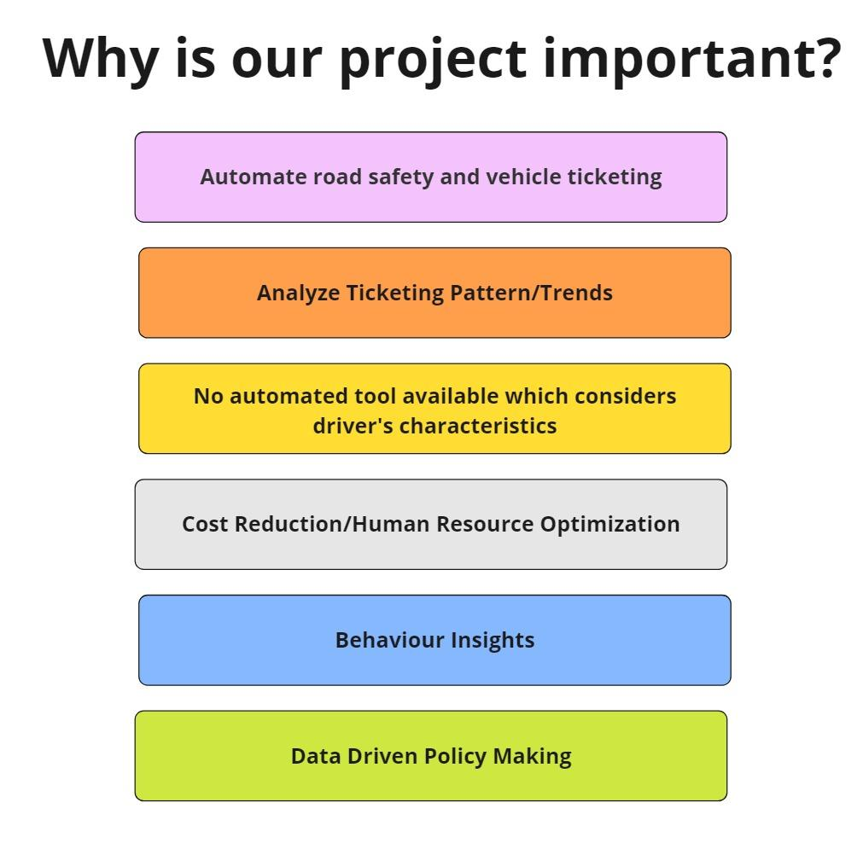
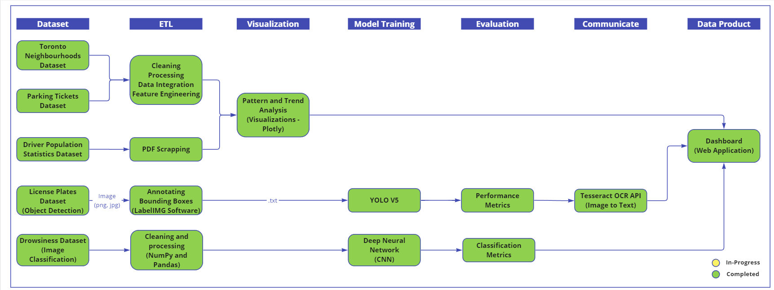
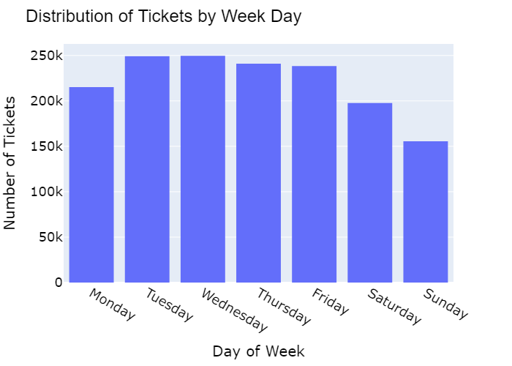
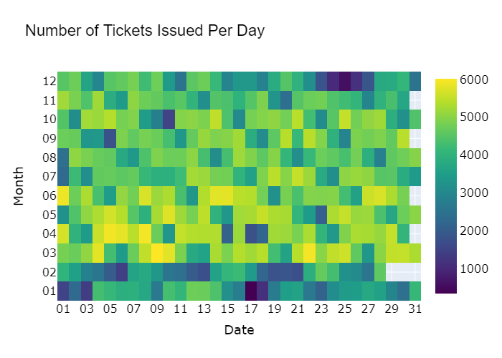
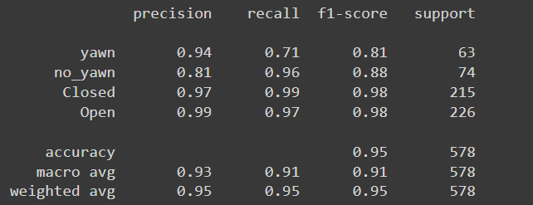
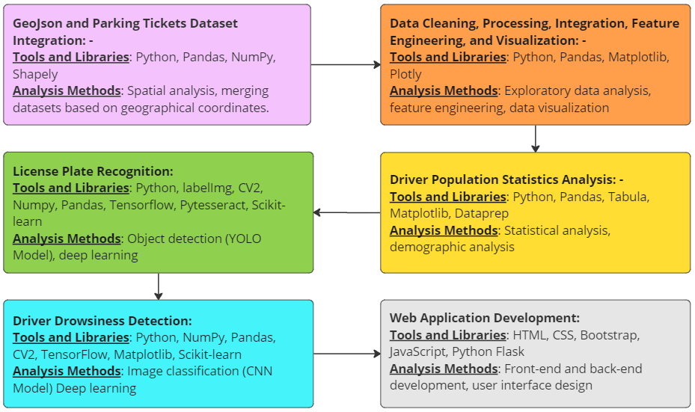
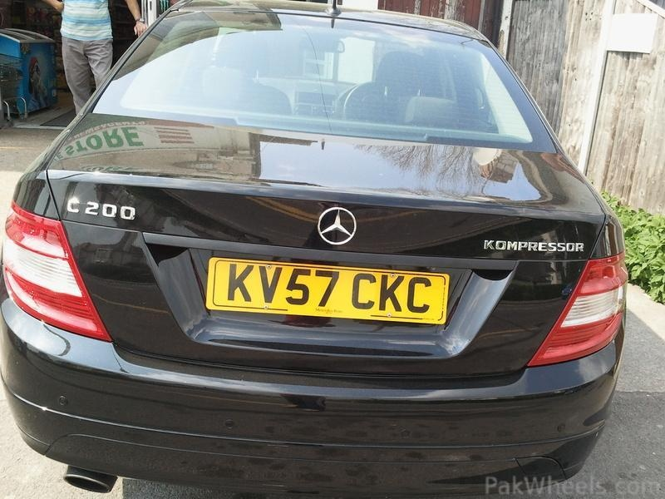
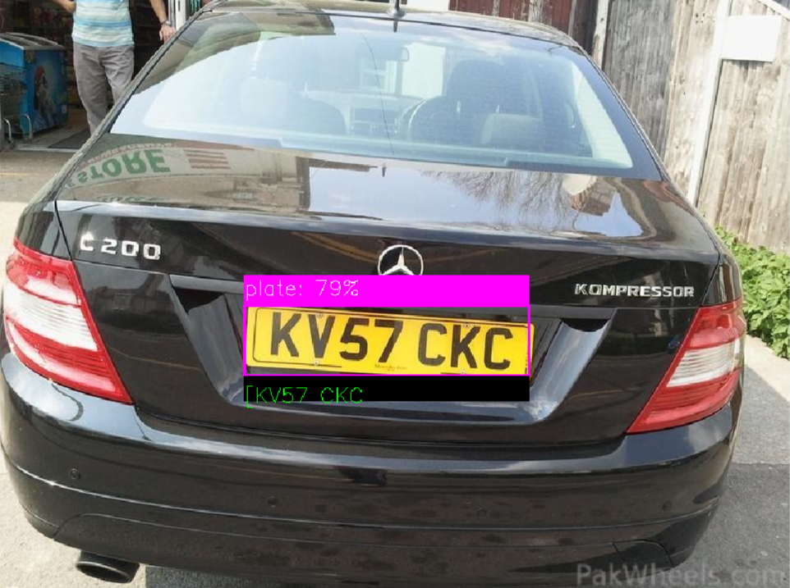
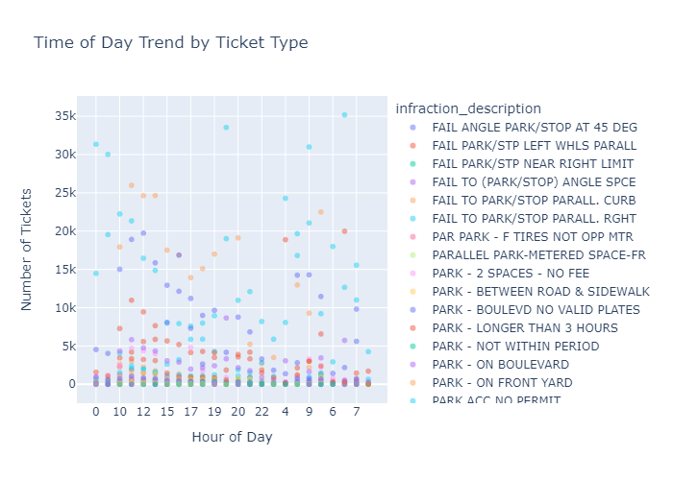
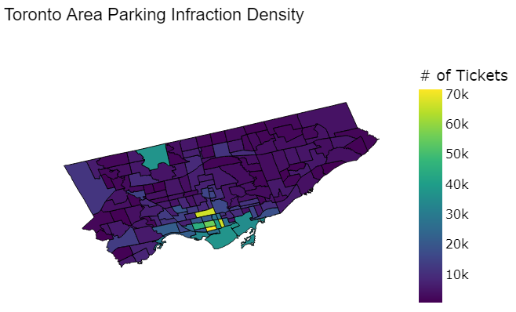
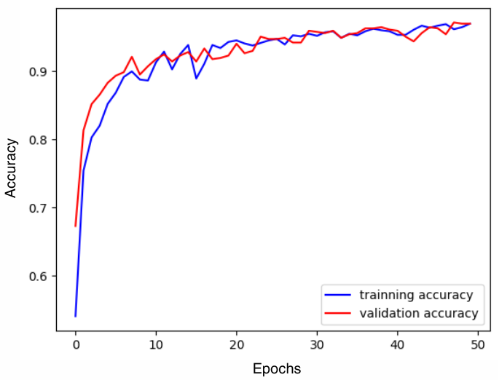
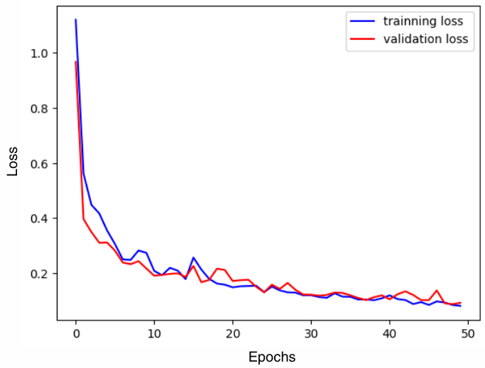
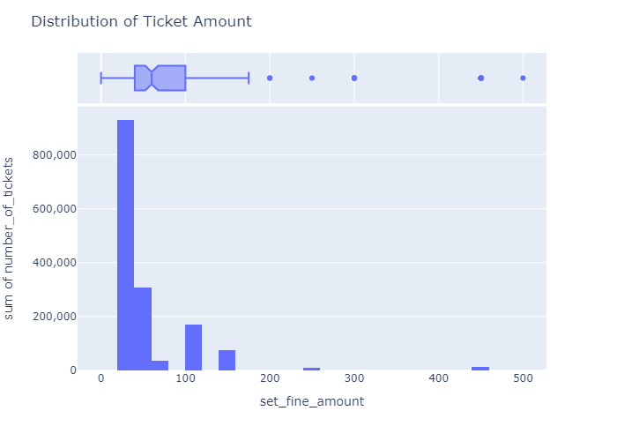
Machine Learning Based Enhanced Road Safety
Data Trio: Midhun Jisha Manoj, Risheek Sood, Shaik Sohail Hasan
Project Impact
Pipeline
Problem Statement
Drowsiness Detection:
Currently, there's a noticeable absence of automated tools that factor in driver characteristics. This raises the question: How can we leverage machine learning algorithms to detect driver drowsiness in real-time, thereby preventing accidents caused by drowsy driving?
License Plate Recognition:
Accountability is key to ensuring safety, especially concerning vehicles. Thus, our focus is on identifying number plates to hold individuals accountable. How can we develop and implement a machine learning model to accurately recognize and extract license plate numbers from images for the automated enforcement of traffic rules and regulations?
Ticketing Analysis:
Understanding the significant factors contributing to parking infractions in Toronto is crucial. Moreover, analyzing these factors to uncover trends and patterns in parking ticket issuance can inform strategic deployment and optimization of human resources, reducing costs while enhancing performance.
Datasets
Results
Parking Tickets: https://open.toronto.ca/dataset/parking-tickets/
Toronto Neighbourhoods: https://open.toronto.ca/dataset/neighbourhoods/
Driver Population Statistics: https://data.ontario.ca/en/dataset/driver-population-statistics
License Plate Recognition: Open Images Website
Drowsiness Detection: https://www.kaggle.com/datasets/dheerajperumandla/drowsiness-dataset
Ticketing Analysis
License Plate Recognition:
Driver Drowsiness Detection
Efficiently pinpointing high-violation areas enables targeted resource allocation, promoting traffic safety and enhancing overall safety for drivers, passengers, and pedestrians.
Using YOLOv5, precision is perfect (1), recall is high (0.958), and mean Average Precision (mAP) at IoU 0.5 is impressively high (0.993), yet the overall mAP score (0.734) suggests challenges with overlapping or closely packed objects.
The accuracy and loss graphs demonstrate strong convergence, indicating balanced generalization and absence of overfitting, with both training and validation metrics closely aligned throughout training.
Methodology and Tools
Project Learnings
Future Scope
Data Product
Data Gathering and Integration
Data Cleaning
Processing, and Visualization
Project Management
Model Development
Web Application Development
Problem-Solving and Troubleshooting
Skills Acquisition and Transferability
Incorporating pedestrian information to analyze interactions between drivers and pedestrians for comprehensive road safety assessment.
Dataset: https://universe.roboflow.com/vincent-huard-axo4r/dataset_0610
Integrating weather data to provide insights into road conditions affecting safety.
Dataset: https://climatedata.ca/download/
Integrate with emergency response services.
Dataset: https://data.sfgov.org/dataset/EMSA-Emergency-Medical-Services-Response-Times-Dat/faug-73ss/data_preview
Website Link: https://youtu.be/wa_gxY8OSuE
GitHUB Link: https://github.sfu.ca/mja125/ML-Based-Enhanced-Road-Safety

Slide 3
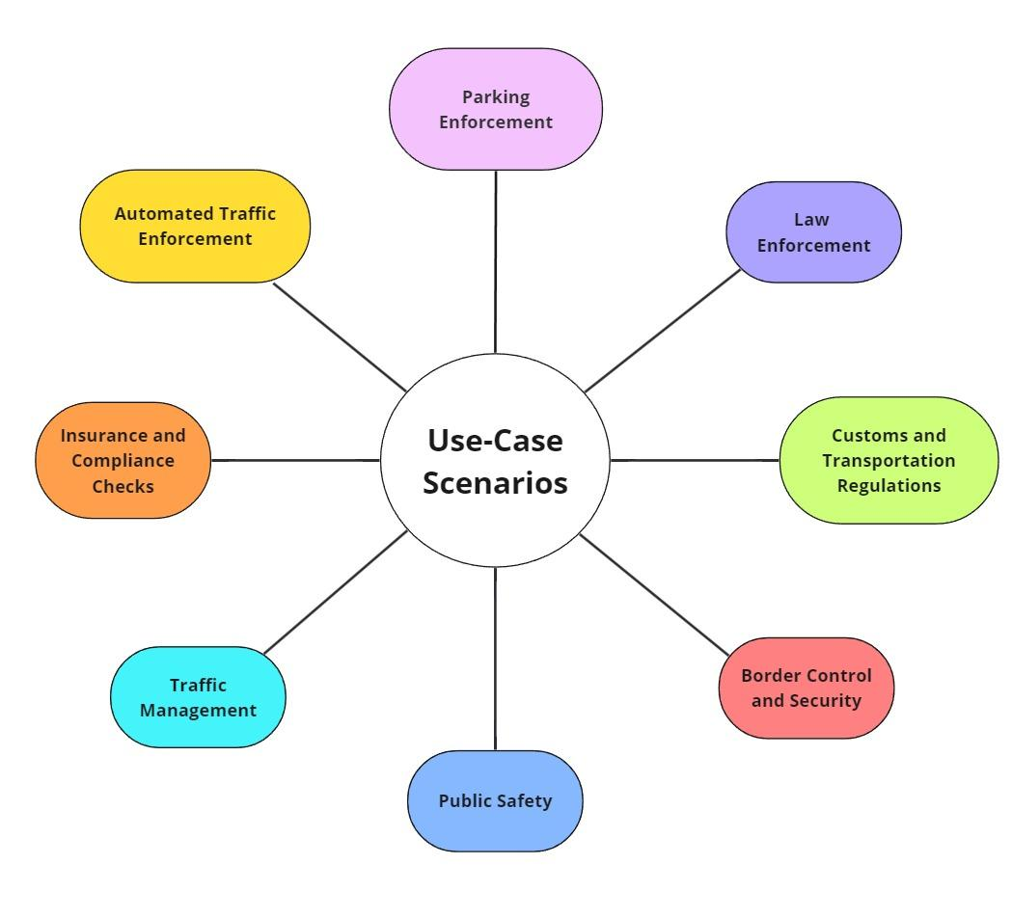
Use-Case Scenarios

Slide 4
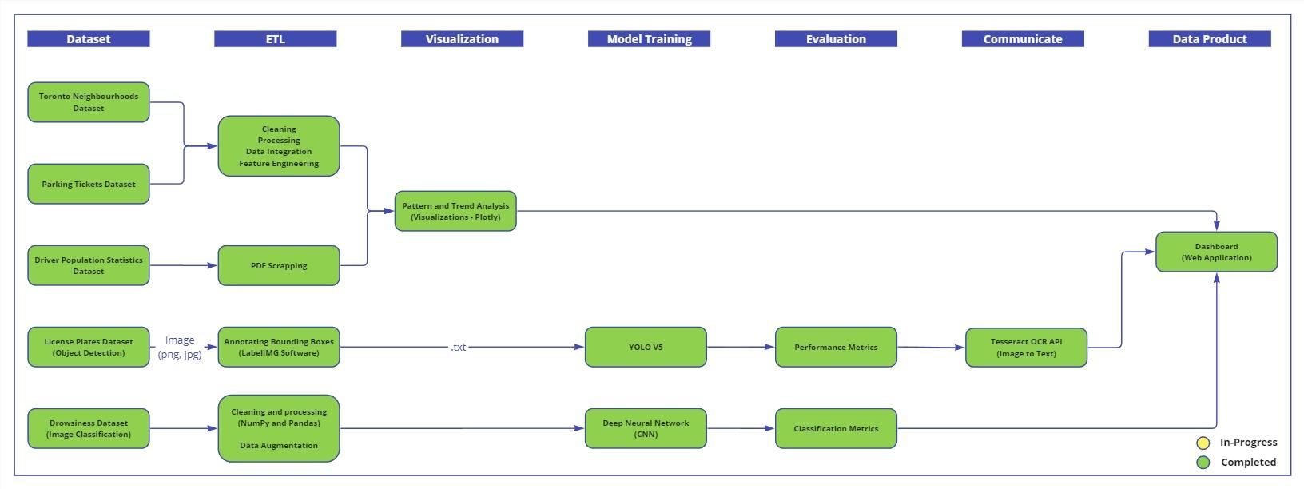
PROJECT PIPELINE

Slide 5
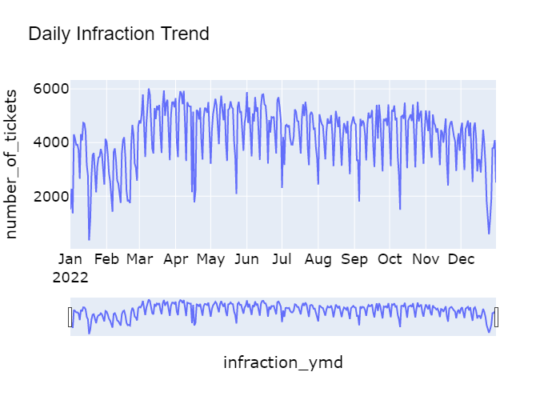
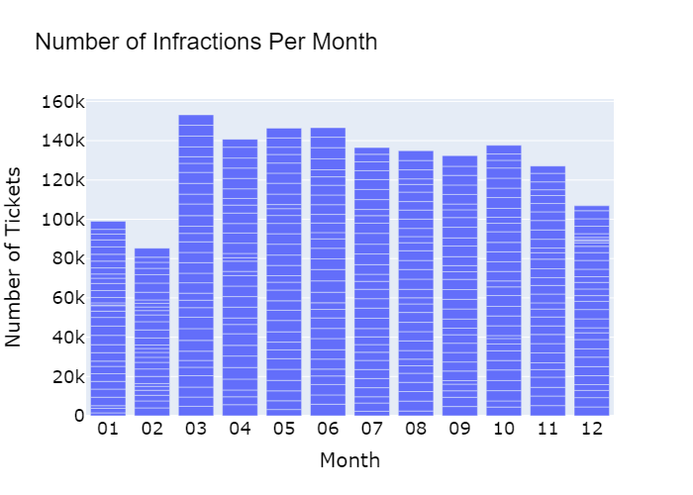
TICKETING ANALYSIS

Slide 6
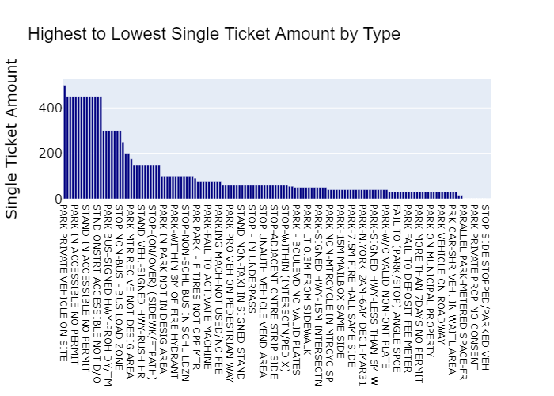
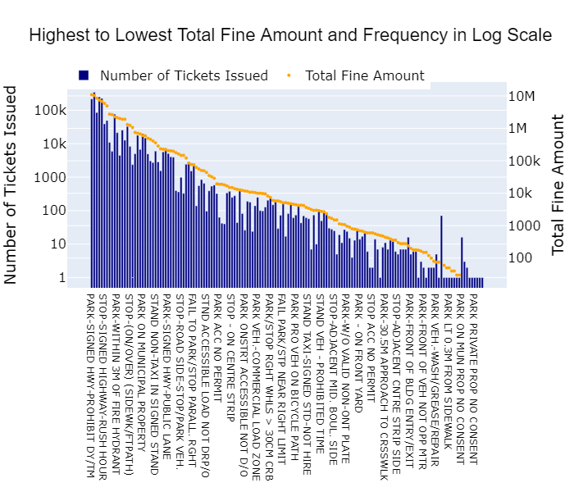
TICKETING ANALYSIS

Slide 7
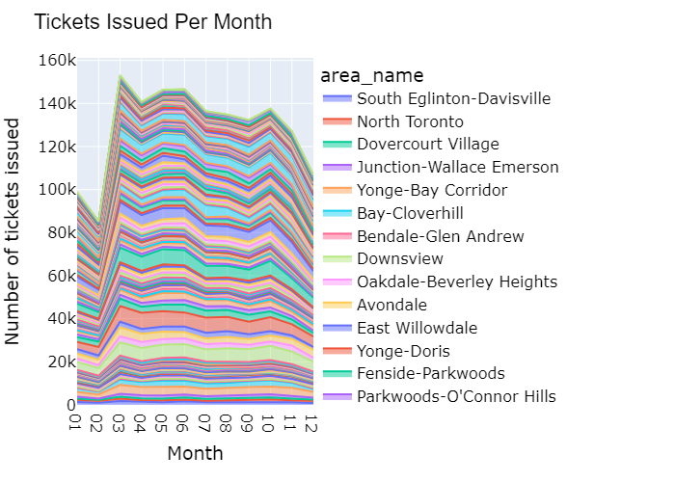
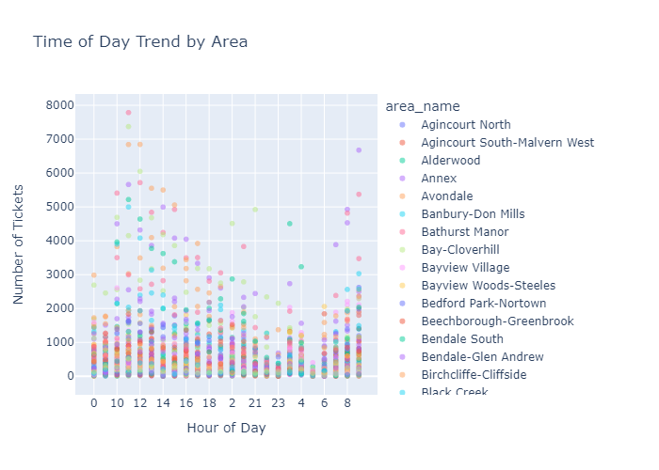
TICKETING ANALYSIS

Slide 8
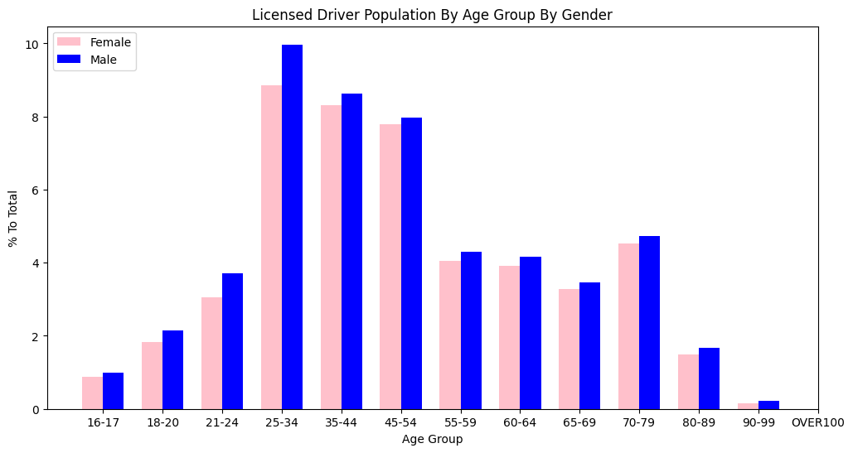
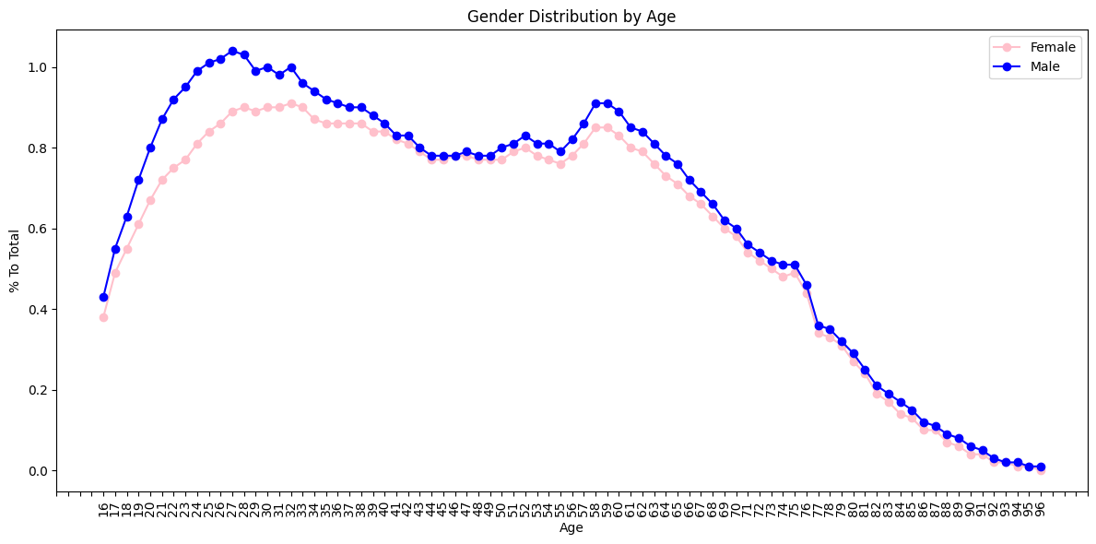
DRIVER POPULATION STATISTICS

Slide 9
LICENSE PLATE RECOGNITION - RESULTS
Model Input
Model Output

Slide 10
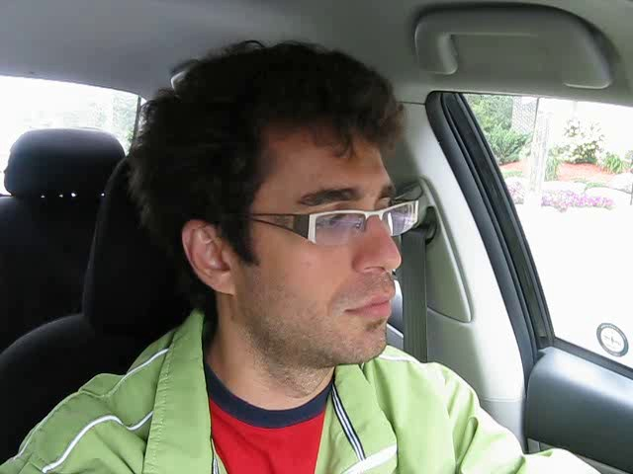
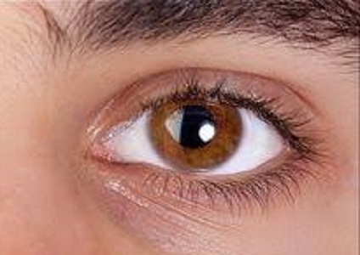
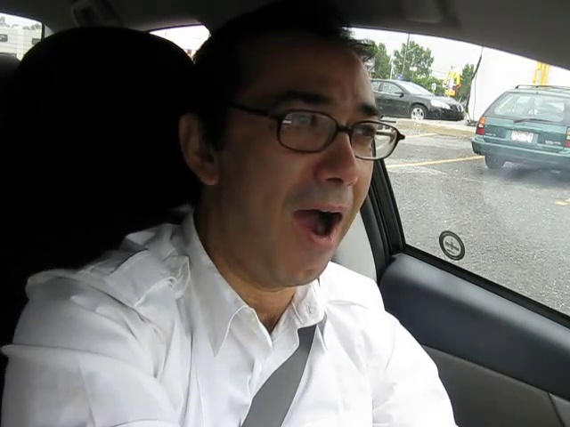

DRIVER DROWSINESS - RESULTS
Different Classes for our Classification Model

Slide 11
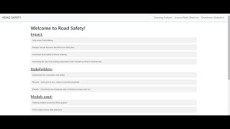
Data Product / Website
Youtube Link: https://youtu.be/wa_gxY8OSuE

Slide 12
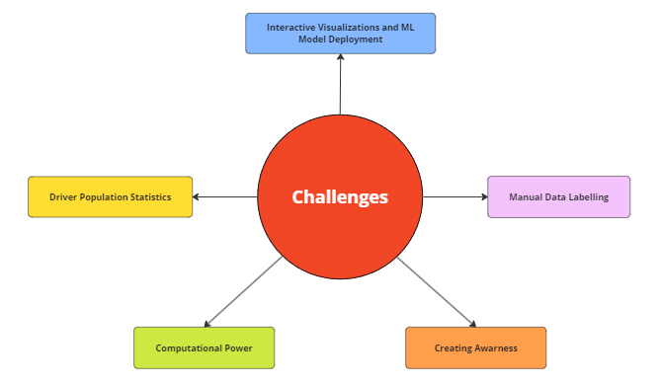
CHALLENGES

Slide 13
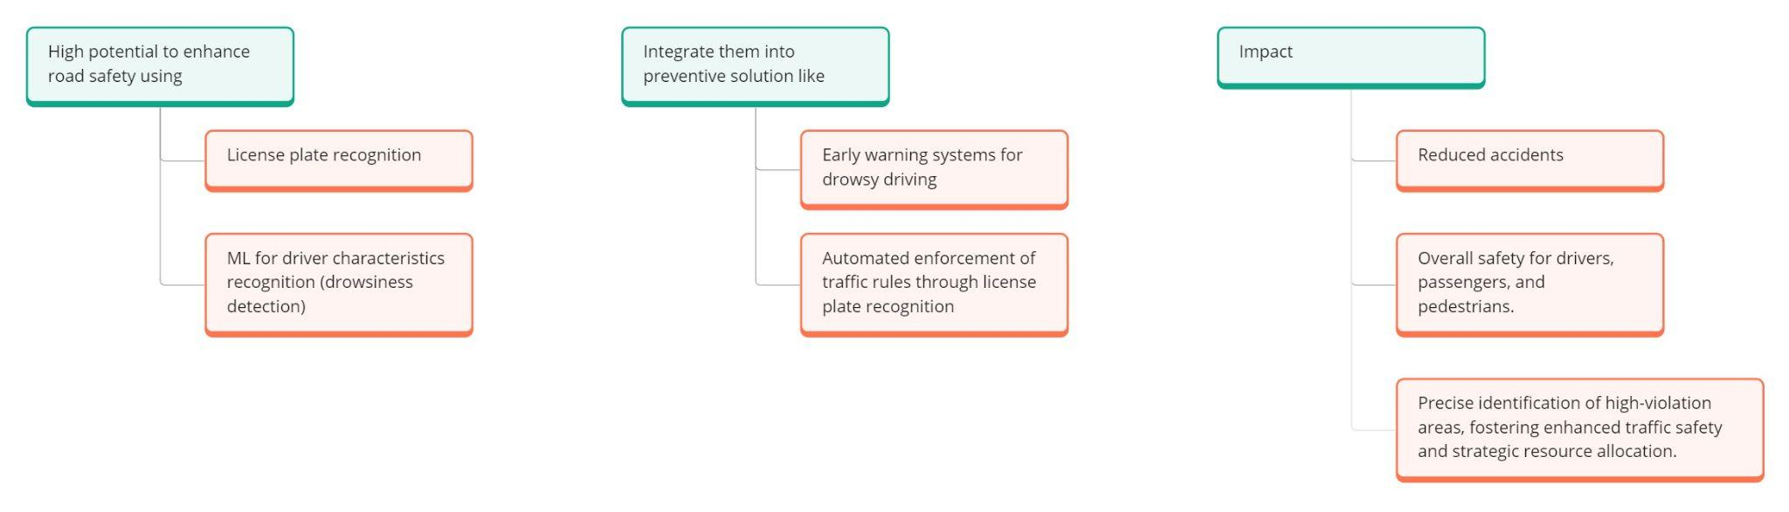
CONCLUSION

Slide 14
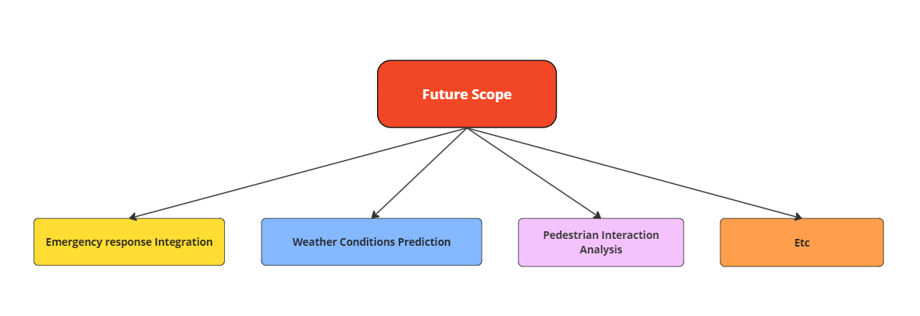

Slide 15


